Slide 1
Soldering Station
Joos Vanhees
1PBEAI

Slide 2
Table of contents:
Introduction
The assignment
The PCB design
Altium Designer
Case design
Discussion
Q&A

Slide 3
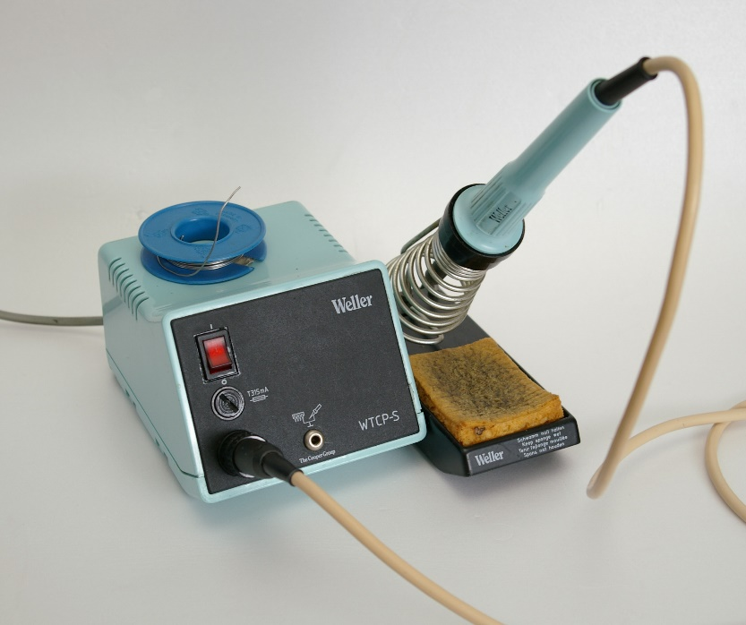
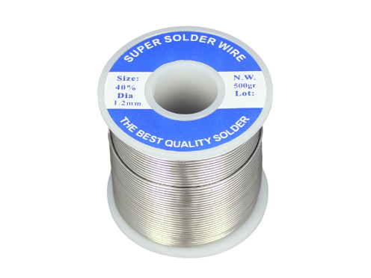
Introduction
The assignment:
Making of
Usage of the software
PCB design
Case design

Slide 4
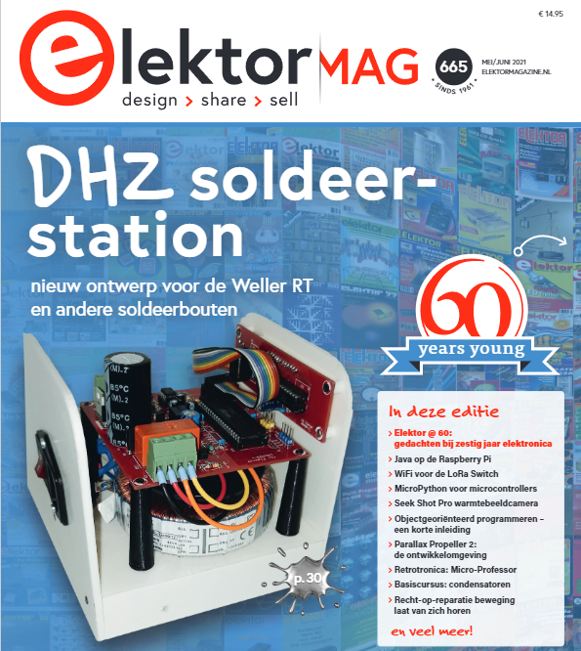
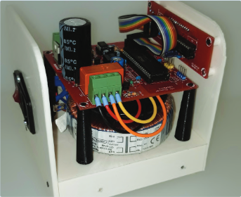
The assignment
Elektor magazine
Base template
General idea

Slide 5
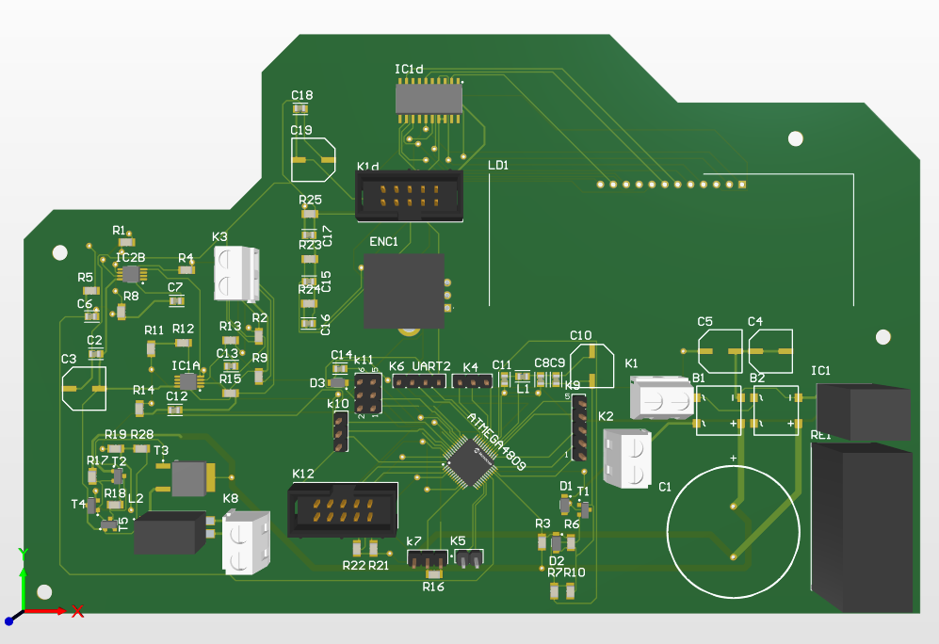
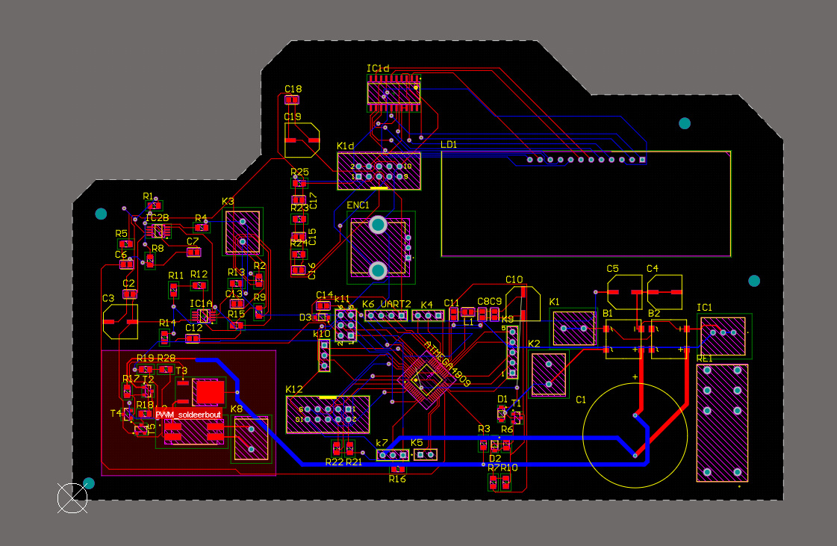
PCB design
Altium designer
Special design
Fitment in the case
As many SMD components as possible
Material:
FR4
Rigid strong material
Lightweight
Affordable

Slide 6

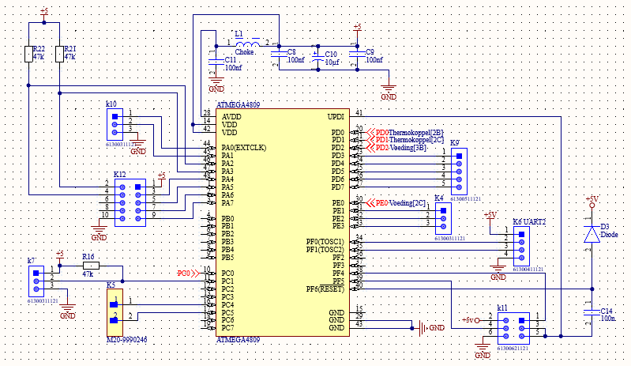
Altium designer
PCB development software
Globally used
Professional
Constantly updated

Slide 7
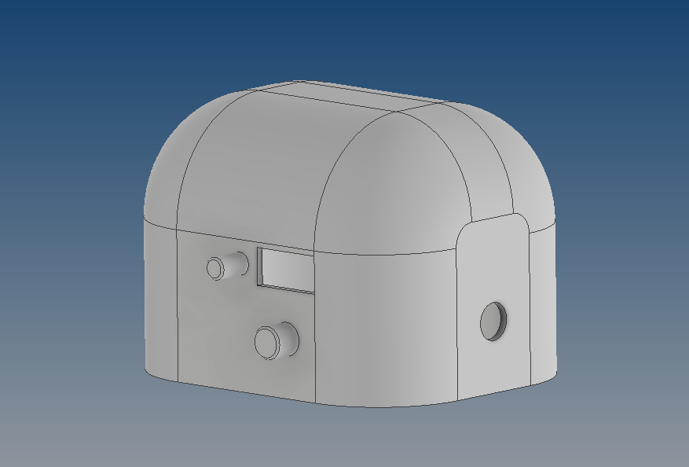
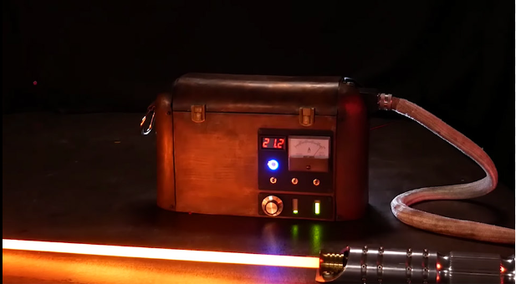
Case design
Inventor Pro
User friendly
StarWars design
Proto saber
Ideal design
Material used:
PLA: strong, cheap, relaible and ecological material

Slide 8

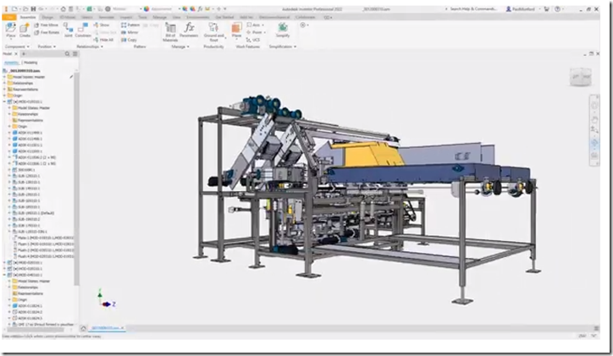
Inventor Pro
User friendly
Easy to learn
Multiple uses

Slide 9
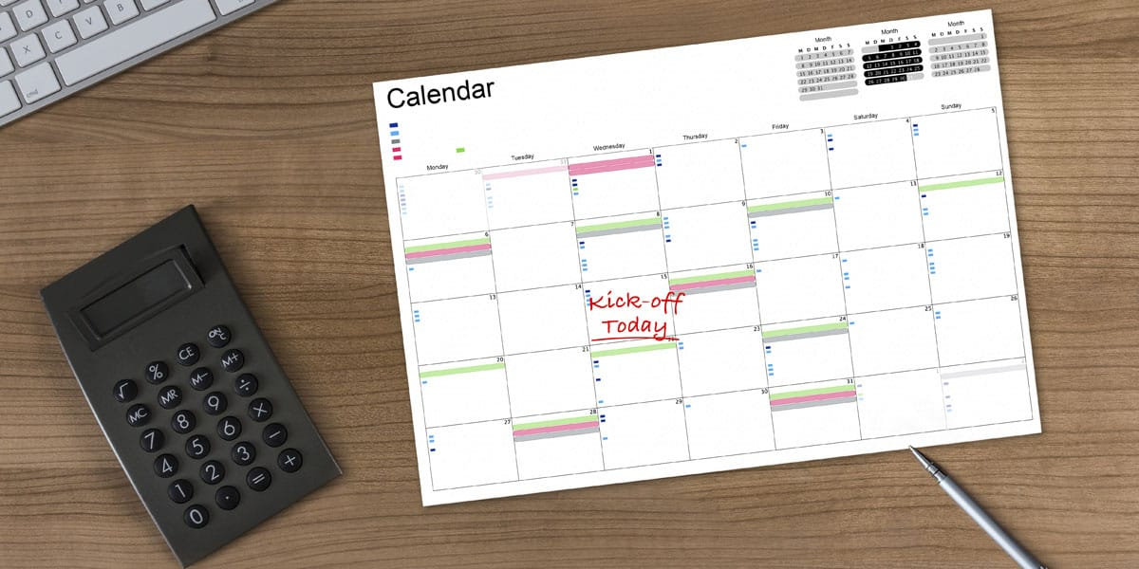


Discussion
Deadlines
Working indepentandly
Doing everything yourself
Freedom in design
Using the wrong schedule

Slide 10

Q&A?

